Slide 1
Arrays and Code Quality
Oliver kerr
okerr@uclan.ac.uk

Slide 2

Variables: Concept
A variable is a labelled box containing a single value of a given type:
What if we need several related values?
Perhaps create several variables:
int width;
int height;
Or maybe use this shorthand style:
int width, height;
But what if we needed 100 related values…
?
6
6
12
Val: int
Val: int
Val: int
Declaration
int Val;
Declaration & Initialisation
int Val = 6;
Val = 12;
Assignment

Slide 3
Arrays: Concept
An array is a single variable that can store multiple values
Think of it as a set of drawers
The drawers as a whole have a label, the array name
Each individual drawer is numbered, starting at 0
These are called the array indexes
Arrays are a type of collection or container
There are other types that you may see later in your course
Array Index
"Joe"
0
"Ann"
1
"Bob"
2
"Tim"
3
"Jay"
4
"Ira"
5
Array name is
userNames
userNames: string array

Slide 4
Arrays: Usage
In C++ all the values in an array must have the same type
We can have an array of integers, or an array of strings
But not a mixed array of strings and integers
In C++ each array has a fixed number of ‘drawers’
For example, if we create an array of 10 integers then that array will always hold 10 integers
We cannot add more or remove any later
We call this the array length
Arrays (and other containers) are used to holds lists of things:
An array of user names
An array of computer network addresses
An array of file names

Slide 5
Creating an Array
Declare an array in C++ using square brackets []
int arr[4]; //An array of 4 integers
However, none of the elements currently have a value.
Array Index:
0
1
2
3

Slide 6
Initialising an Array
Like when intialising a variable, we can initialise each element in the array to a specific value.
int arr[4] = { 10, 2, 4, 8 };
0
1
2
3
10 | 2 | 4 | 8

Slide 7
Accessing Individual Elements
Once we have Initialised the array we can access individual elements using the square bracket syntax.
cout << arr[0] << endl; //Outputs 10
cout << arr[1] << endl; //Outputs 2
cout << arr[2] << endl; //Outputs 4
cout << arr[3] << endl; //Outputs 8
cout << arr[4] << endl; //ERROR Out of bounds!
0
1
2
3
10 | 2 | 4 | 8

Slide 8
Accessing Individual Elements
We can also assign values to each element in the array.
arr[0] = 15;
cout << arr[0] << endl;
0
1
2
3
15 | 2 | 4 | 8

Slide 9
Array Examples
string userNames [] = { "Joe", "Jane", "Jack" };
cout << "First user is called " << userNames[0];
cout << "Second user is called " << userNames[1];
cout << "Third user is called " << userNames[2];
double grades[] = { 72.0, 56.5, 61.1 };
// Add up the grades and divide by 3 to get the average
double averageGrade = (grades[0] + grades[1] + grades[2]) / 3;
cout << averageGrade << endl;
Output:
First user is called Joe
Second user is called Jane
Third user is called Jack
Output:
63.2

Slide 10
Arrays and For Loops
double grades[] = {72.0, 56.5, 61.1};
for (int index = 0; index < 3; index++)
{
cout << grades[index] << endl;
}
The loop variable index starts at 0 and counts up to 2.
Careful: It doesn’t count to 3 because it says <3
So first time around the loop index = 0 and the code executes:
cout << grades[0] << endl;
Then the next two times around the loop index = 1, then 2 cout << grades[1] << endl; cout << grades[2] << endl;

Slide 11
Readability: Indentation
Several times we have focused on readability. There are three readability considerations that are important:
Variable names, comments and indentation
We have already looked at variable names and comments
Indentation is using tabs or spaces at the start of each line to push the code in and show the structure:
while (userGuess != "tomato") // Loops while the user is wrong
{
cout << "Wrong, guess again: " << endl;
cin >> userGuess; // User has another guess
}
The lines inside the while loop are pushed inwards
Usually use a single tab, or 4 spaces (either, but be consistent)

Slide 12
Readability: Indentation Example
Very bad indentation:
Probably from copy and pasting without tidying up afterwards
Same code, correct indentation (line up matching braces, easy to read):
for (int i = 0; i < 10; i++)
{
for (int j = 0; j < 10; j++)
{
cout << "X";
cout << "X";
}
cout << endl;
}
for (int i = 0; i < 10; i++)
{
for (int j = 0; j < 10; j++)
{
cout << "X";
cout << "X";
}
cout << endl;
}

Slide 13
Code Quality: Testing
We always need to test our code. We know what we expect the program to do and we have looked at debugging already. But user input can cause a huge range of unexpected problems. So we need to test thoroughly.
Question. What kind of mistake can the user make when inputting:
Numbers?
Text?
Numbers: Too large and small values, negative values, 0, floating point values, letters or symbols instead of numbers
Strings: Upper and lower case combinations, the empty string (just press return), spaces in strange places
In both cases, special key combinations (like Alt+F4, or Ctrl+C)!
Completely robust code needs to consider all these cases (except perhaps special keys)

Slide 14
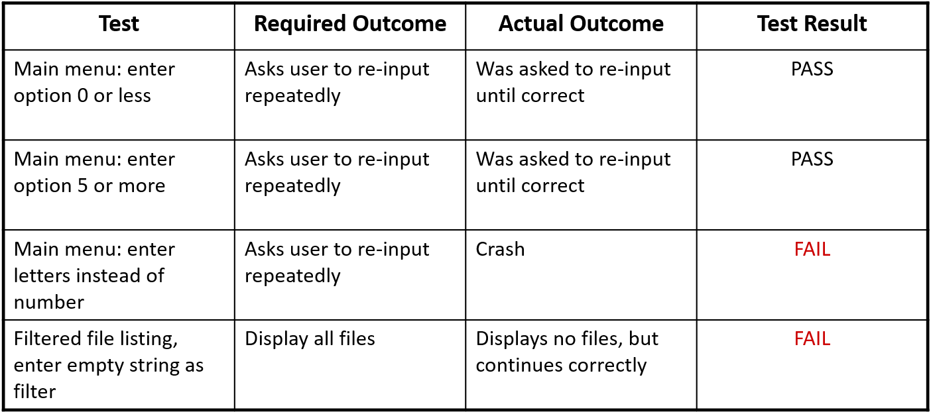
Code Quality: Testing Plan
On other modules you will consider testing in detail.
At this stage we might want to consider an informal test plan: a list of all possibilities that you go through & check:

Slide 15
Code Quality: Literals
A literal is a specific value typed directly into the program:
int numberStudents = 180;
string characterType = "Warrior";
numberStudents and characterType are variables
180 is an integer literal
"Warrior" is a string literal
Literals occur frequently in programs
How many literals in this code?
for (int i = 0; i < 80; i++)
{
cout << ("-");
}

Slide 16
Code Quality: Magic Numbers
Why does this code use the literal value 80?
for (int i = 0; i < 80; i++)
{
cout << ("-");
}
It’s because the default width of a console window is 80 characters
So this will draw a line across the full width of the window
I know that and maybe some of you do too, but many wouldn’t
That 80 is an example of a “magic number”
A literal value with a special meaning
But because it’s a literal the reader cannot see what the meaning is
Magic numbers are poor programming practice

Slide 17
Code Quality: Handling Magic Numbers
Magic numbers are a problem because:
Confusing if the reader doesn’t know why they were chosen
You could use comments to help here, but we will see a better solution
May be many copies of the same magic number around your code
If we want to draw a box around the window, or write some text at the right of the window, in both cases we would need this same 80 value
This could lead to bugs (using different values in different places)
So how can we remove this magic number 80?
for (int i = 0; i < 80; i++)
{
cout << ("-");
}

Slide 18
Code Quality: Handling Magic Numbers
We can define a variable to hold the magic number
And give that variable a good descriptive name:
int consoleWidth = 80;
for (int i = 0; i < consoleWidth; i++)
{
cout << ("-");
}

Slide 19
Code Quality: Constants
However, if we use a variable to handle magic numbers the value can be changed.
We may not want that, perhaps the console width is constant
Changing the variable’s value might cause problems
In C++ you can declare any variable with the word const at the start
The variable is constant and it is an error to change the value
Example uses a constant member variable available to all methods
Ideal solution for magic numbers
const int consoleWidth = 80;
for (int i = 0; i < consoleWidth; i++)
{
cout << ("-");
}

